Slide 1
Prediction of Beta-Amyloid based on MRI : PCA unsupervised learning
Hunsi Jayaprakash, Undergraduate Department of Computer Science
CS Advisor: Dr. Joseph Yurko
Capstone Research Project

Slide 2
Purpose of Study
My research project aims to predict Beta-amyloid accumulation from magnetic resonance imaging (MRI) in a novel approach using an unsupervised learning technique - Principal Component Analysis (PCA) - to find prominent clusters or regions of interest through dimensionality reduction while maintaining the original structure and relationship of the dataset.

Slide 3
Background
Alzheimer's Disease (AD) is the sixth leading cause of the death in the United States.
AD is a process of progressive neurodegeneration of brain structure and function. This process of neurodegeneration begins years prior to significant cognitive decline and is associated with cerebral beta amyloid (Aβ) accumulation.
Aβ is a neurotoxic protein which is found in healthy individuals; however, at abnormal levels it has been associated with a series of events that lead to network breakdown of the nervous system.
Preclinical-AD → Early stage of significant amyloid pathology without overt cognitive dysfunction
Previous Literature → Strong association between Aβ accumulation and neurodegeneration, so it is possible to hypothesize that neuronal loss –neurodegeneration - will occur asymmetrically.

Slide 4
Hypothesis
We hypothesize that dimensionality reduction will aid in fitting predictive models to generate accurate estimates of Aβ and will enhance our understanding of early Aβ deposition and its interactions with structural and functional neuronal loss

Slide 5
Data Collection and Preparation
Cross-sectional study from ongoing large center study (PI: Klunk & Aizenstein)
n = 85 (mean age = 76.4±6.1 years)
Cognitively normal adults underwent magnetic resonance imaging (MRI) and positron emission tomography (PET) with Pittsburgh compound B (PiB) and Fluorodeoxyglucose (FDG) tracers to estimate Aβ and glucose metabolism, respectively.
Response Variables : PiB, GMD, FDG
Reshaped Data to Wide Format → Multiple measurements of the same subject, across time or using different tools (ex. PiB, GMD, FDG, regional vs. global)

Slide 6

Methods (PCA)
Reshape and Clean Data
We performed Principal Component Analysis (PCA)
Generated 52 PCs
Generated Plots in R to Visualize PCA
Corrplot()
Screeplot()
Examined Eigenvalues and extracted contributions of variables (Regions) in PC1 – PC7

Slide 7
Methods (PCA)
Alternatively, we also clustered the regions by calculating a correlation-based distance metric
Generated plots to show clustering and cut the tree into Macro and Sub groupings based on the height of the tree
Hclust()
Identified clustered Regions
Lastly, we clustered individual people by the PCs
Clustered by PC score

Slide 8
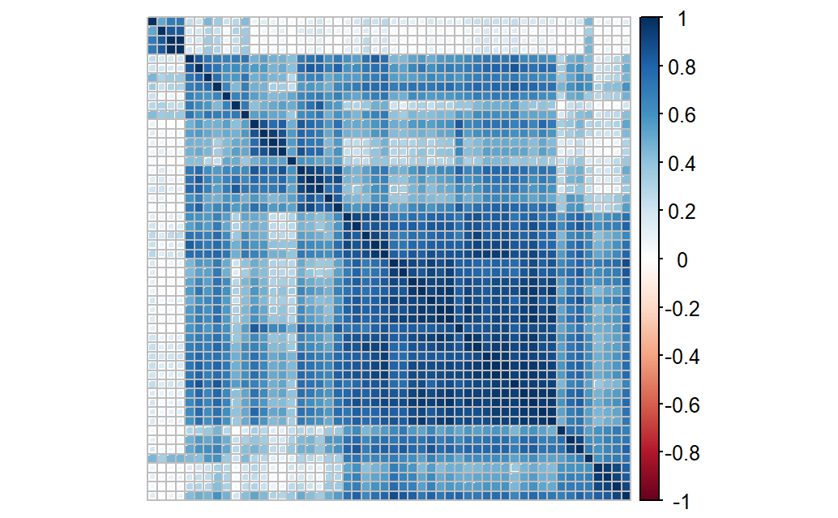
Correlation Plot between Regions -GMD
3 Groupings
Region Name (52)

Slide 9
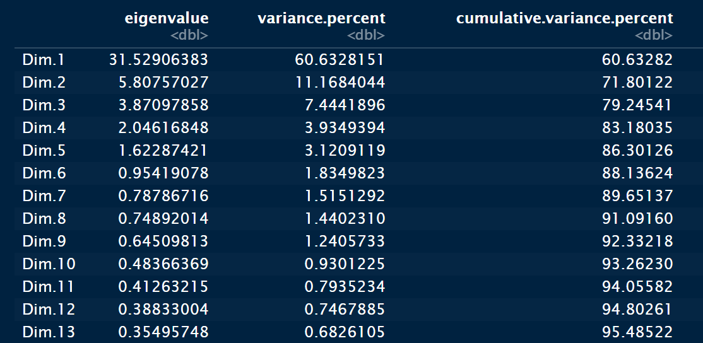
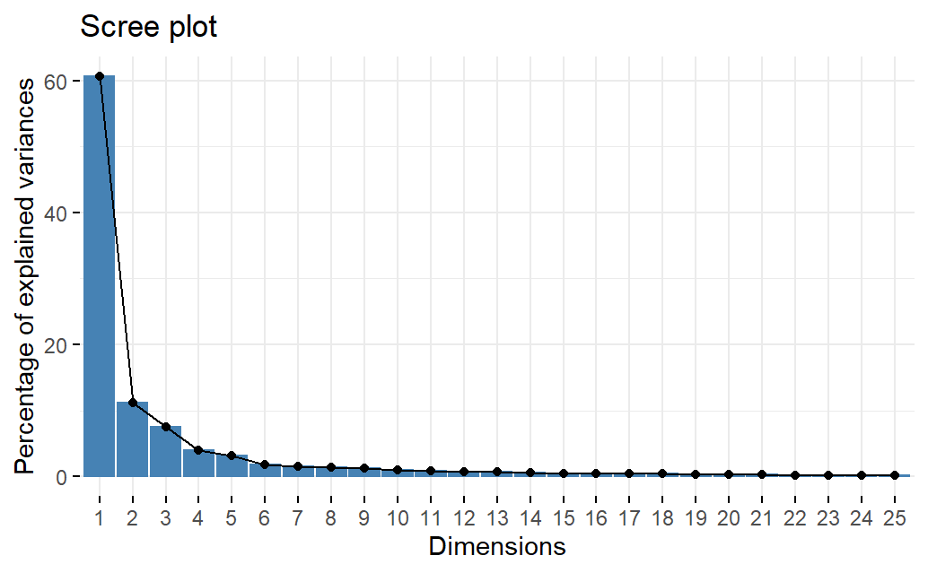
Explained Variables from PCA
Estimated 7-9 PCs that capture explained variances

Slide 10
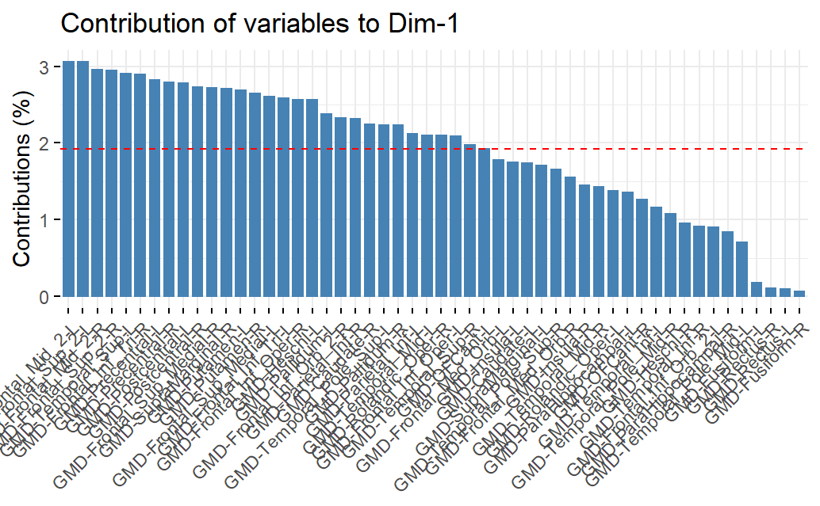
Contribution of Regions and Association with PCs
The horizontal red line represents the threshold of the regions having an equal contribution (100 * 1/52)
Regions above the red line → active
Regions below the red line → inactive

Slide 11
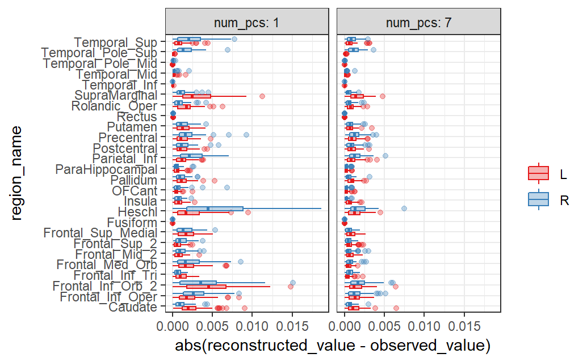
Estimating 7 PCs to explain Overall Variance
PC1-7 drives the error down across all regions

Slide 12
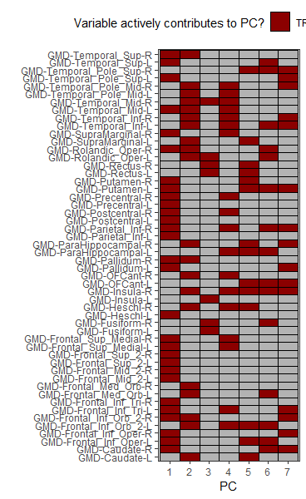
Active contribution to PC

Slide 13
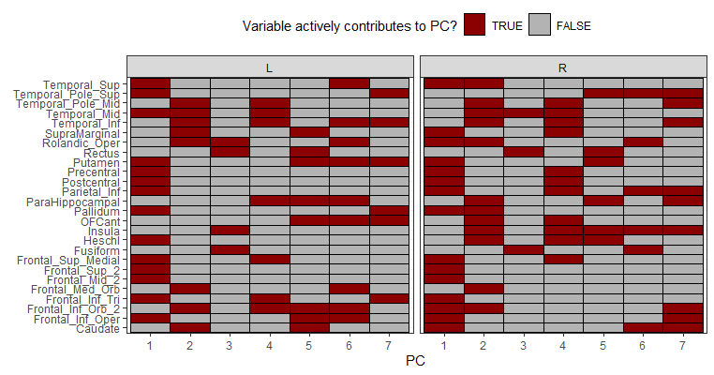
Active contribution to PC – Hemispheric

Slide 14
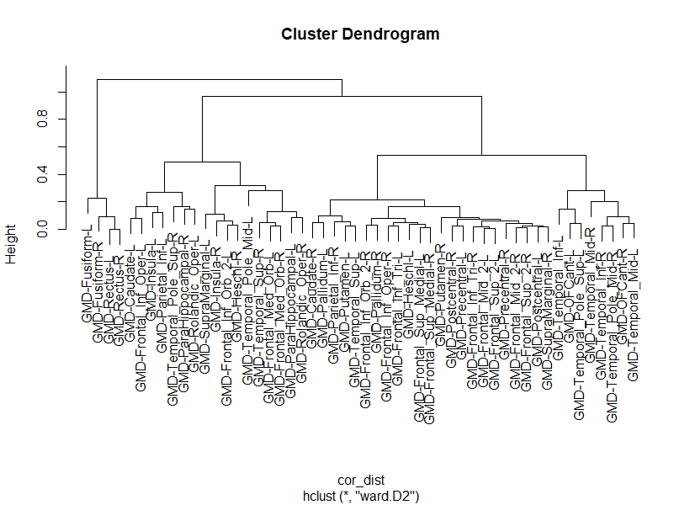
Hierarchical Clustering
Hierarchical clustering based on correlation distance

Slide 15
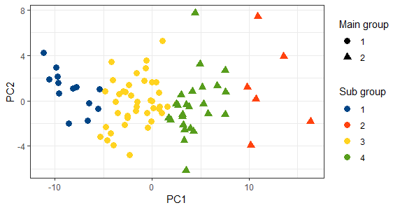
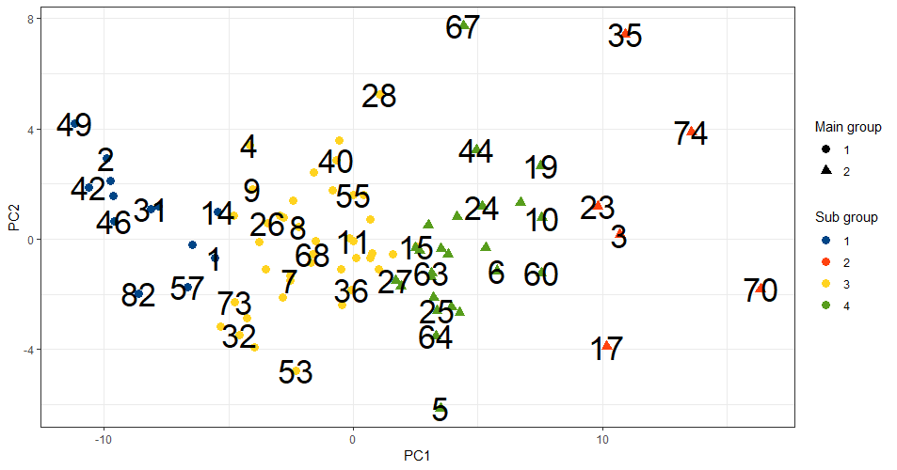
Cluster observations by PC scores and by Individuals

Slide 16
Discussion
From the PC analysis we can observe that the first seven PCs are able to capture the explained cumulative variances (~ 90% )
The correlation plot shows that certain variables or regions are highly correlated with others (3 Main groupings) thus allowing us to use dimensionality reduction to explain interactions and relationships between regions
By performing PCA and showing clusters by PC scores, contributions of regions, and patterns in the individual people we can use this information to find a suitable predictive model that will be able to predict beta amyloid (3D CNN)

Slide 17
Limitations and Next Steps
Some limitations for our project include a smaller data set size of 85 individuals. This could lead to overfitting the potential predictive model due to a high dependency on the training set leading to a less accurate prediction of beta amyloid on the testing set.
Currently we have only examined the PCA in Grey Matter Density we will repeat the above process for cerebral glucose and PiB
Next steps:
Identify trends between the three response variables in either the contribution of region, number of PC scores used to explain the variance, and identify common demographic patterns and individuals that are in the same cluster.
Overlay the heatmap onto a brain atlas using ggsegHo to visualize the clusters https://github.com/ggseg/ggsegHO
Compare performance of unsupervised techniques (PCA) vs 3D CNN

Slide 18
Thanks for Listening! ☺

